Slide 1


Pink tax?
Gendered pricing in UK supermarkets
PP422 Mini capstone for Economics Observatory
Aleksandra Jaremko
Cyril Estier
Ignatio Ouerta
Sam Bickel-Barrow

Slide 2
Motivation
Pink tax (price gap) understood as the price difference in the unit price of a product where treatment is being marketed towards women.
Followed methodology in Moshary, Tuchman, and Vajravelu (2023) to select product categories
Body wash, cleaning liquid, hair dye, oral care, perfume/cologne, razors, shampoo/conditioners, shaving cream, skincare, supplements
+ Use explicitly labelled products (identified by keywords) to increase model training sample size
- Matching by ingredients not possible
Objectives:
Identify price differentials by product category
Analyse differential discounting and price variation for women/men
Conceptual understanding of the pink tax may vary across product categories
For some products, men will be the default customer base, for some it will be women
Do not consider categories where there is not direct comparison, e.g. make-up, nail polish
2

Slide 3
Project pipeline
1. Preprocessing
categorize by breadcrumb
ID explicitly labeled
Explicitly labeled (m/f) N=2,011
Model training
data
N= 2,727
Raw data
N=117,553
Categorized
products
clean and stem
Processed data
N=7,529
unify prices
human coding
Hand labeled (m/f/n) N=716
scrape images
filter interesting categories out
remaining sample
Unlabeled
N= 4,723
Regression analysis
(different specifications)
Bag of words
Results
Final input sample
N= 5,410
Apply to unlabeled
sample
Final class
predictions
Assign gender class
Training/Testing split
70/30
Stacked model
Image classification
Results
Discount prices analysis
Word embeddings
3. Analysis
2. Gender classification
3
Notes:
Mention that we do descriptive and regression analysis on the discounts/regression
75,000 – post categorizing into product categories, post gender classification, lemm
Do we take missing columns out? – everything should have a title data
We use about a 5,000 to calculate the pink tax to run regression
Cutting out the expensive ones – this is 1,000

Slide 4
Classification models
Bag of words
Image classification
Word embeddings
Multiclass logistic regression models
Stacked model
Weighted by importance of words across corpus (TF-IDF)
Unigrams
Remove the most and least frequent words
GridSearch tunning
Regularization
Remove uninformative pixels, e.g. white and black backgrounds
k-means on downloaded images -> dominant colour
Colour decomposition (R, G, B values)
Processed text is encoded using "all-MiniLM-L6-v2", faster and meaningful vector representations
Embedding vector is extracted and used as input
Captures meaning instead of keywords
Negligible performance gains from fine-tuning
Uses predictions as input.
Logit to assign final labels.
Leverages model diversity.
Improved recall for the neutral class.
Accuracy
0.73
Accuracy
0.37
Accuracy
0.67
4
Notes:
Image processing model:
We downloaded the images with the available url. Here, we lost some observations on which URL was no longer available.
Using Kmeans, we identified the dominant color of each product. Number of clusters (K)=3.
We decomposed the dominant color in R, G and B values.
We merged that data with hand labelled data. We split this into training and test data (test = 30% of sample).
We fitted a Logistic regression to predict the label (female, male or neutral).
We assigned female or male labels only to predicted probabilities with a predicted probability higher than >0.5. Default is neutral. If female and male pred. probabilities were higher than 0.5, then the highest was assigned.
Accuracy score: 0.55
The model is not as accurate as the first two models. This is because some gendered targeted products for men and women have similar colours. Although there are some tendencies (male=darker colours, female=lighter/pink colours (see figure 2).

Slide 5
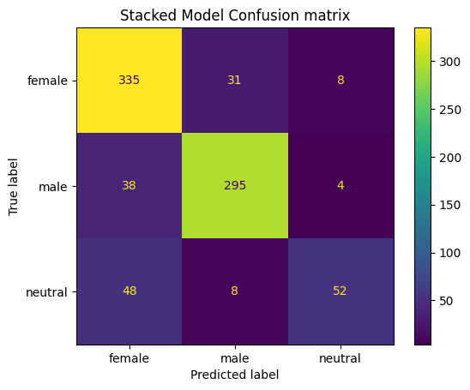
Results of the final classifier
Accuracy:
Precision:
Recall:
0.75
0.83
0.75
Neutral products were hardest to detect due to class imbalance, bringing low recall.
The stacked model performed best in catching neutral, 0.48 against 0.43 for next best model.
Figure 1: Confusion matrix of the stacked model
5

Slide 6
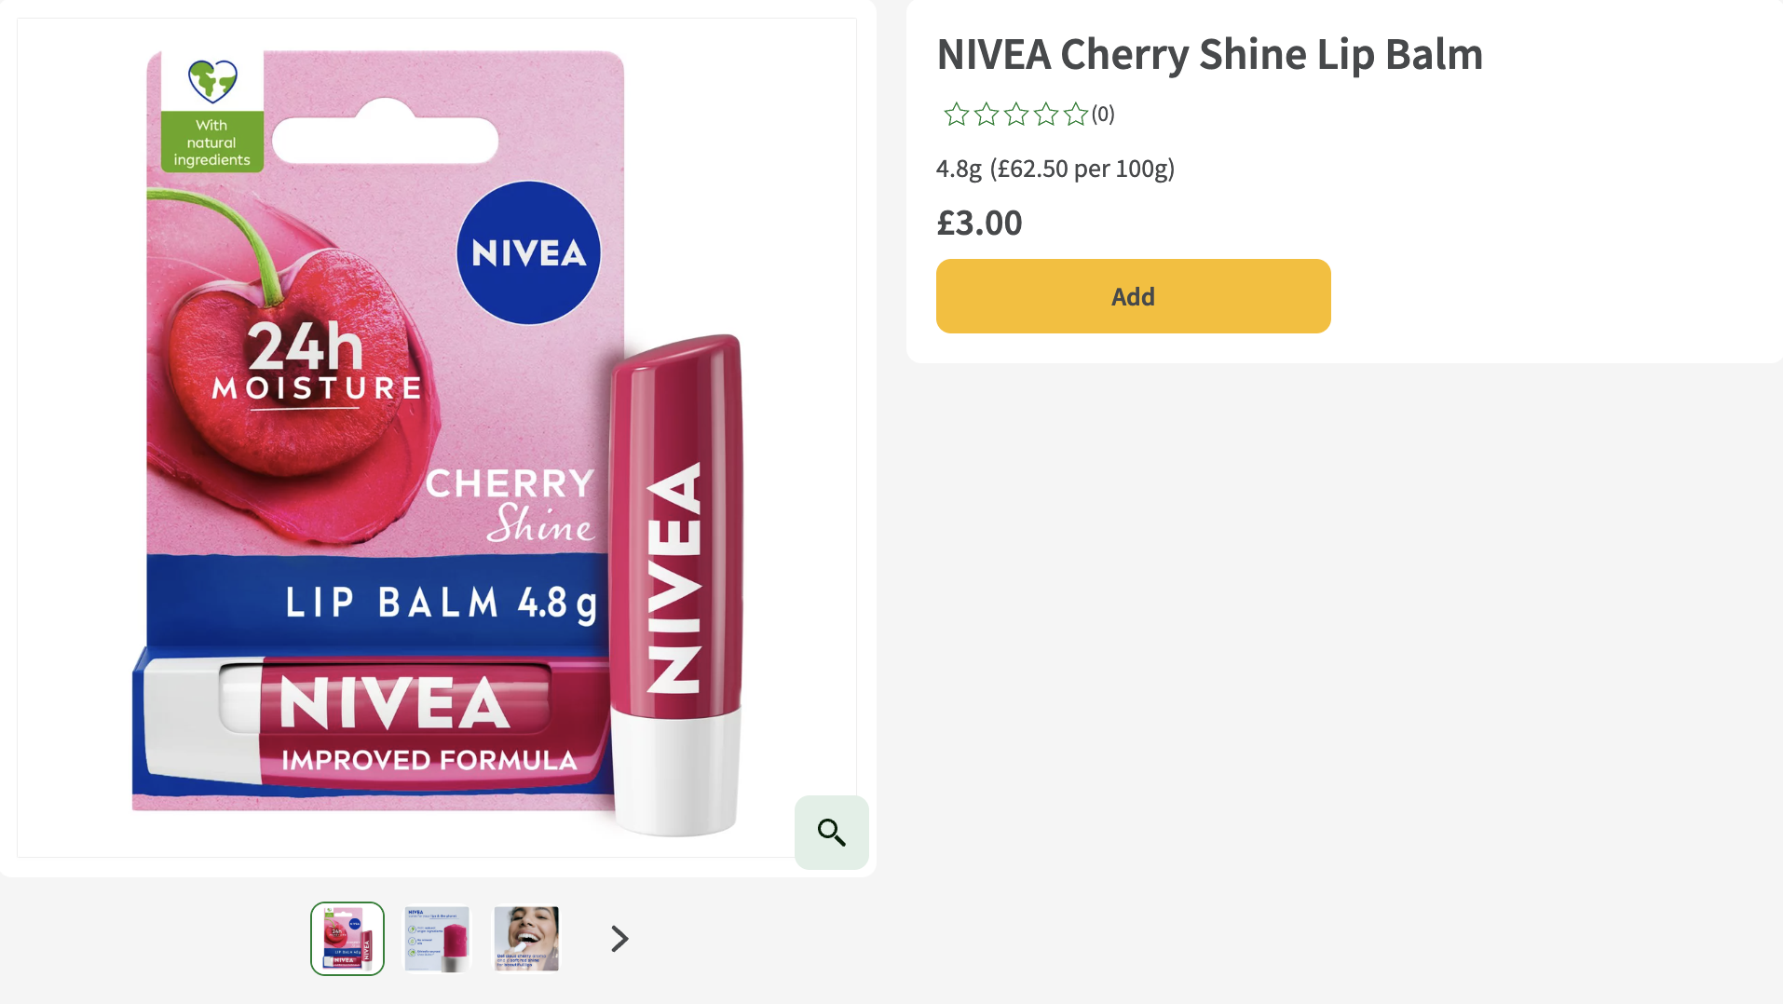
Figure 2: Labelling example
Product classification
working example
Product information
Pamper your lips with a wonderfully delicious cherry aroma and a ruby red tinted shine of NIVEA Cherry Shine Lip Balm. The formula melts into your lips, leaving them moisturised for 24 hours as well as protected against cold, wind and dry air. Clinically tested! Vegan formula. How To Use: Apply lip balm regularly for moisturised lips. Use a lip scrub for extra smooth lips. Recycle the packaging accordingly. Once in a while, use a lip scrub for extra smooth lips.
Figure 2: Labelling example
6

Slide 7
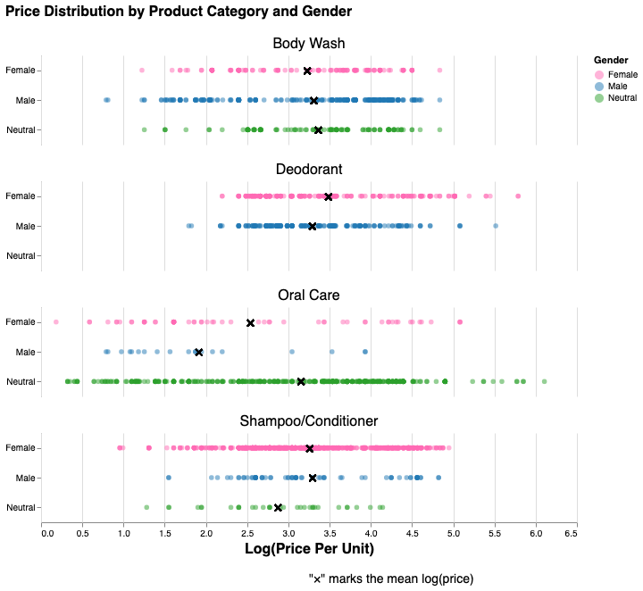
Price analysis
Across gender and product category
We find gendered product marketing varies by category
There is differential variation in price both between female and male products and gendered and ungendered products
Figure 3: Price distributions, selected categories
Note: observations exceeding 1.5 SD lower and upper interquartile ranges were dropped for plotting purposes.
7

Slide 8
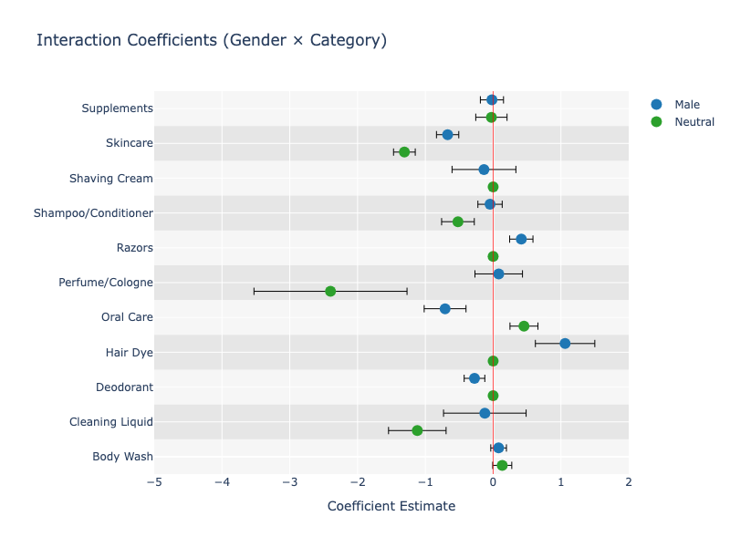
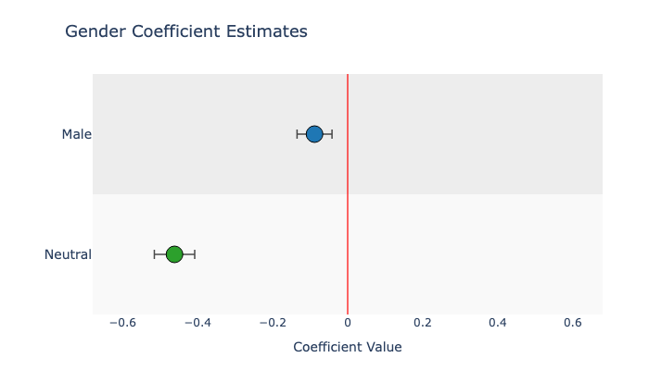
Price analysis
Overall and by category
Specification 1: by gender:
Controls: product category
Men's products are 8.5% cheaper
Specification 2: by gendered: ​​
Controls: product category​​
Gendered products are 54% more expensive​​
Specification 3: interaction terms​​​
Gendered pricing is category specific​​​
Results mirror literature (Moshary, et. al., 2023; Gonzalez, et. al., 2021)​​
Figure 5: Specification 3 estimates
Figure 4: Specification 1 estimates
8
Notes:
Results in literature show the following:
Mosharys, et. al., (2023): female products are more expensive in 4 out of 9 categories (Bar soap, body wash, shampoo, razor blades,)
Gonzalez, et. al., (2021): Women pay more for deodorants/antiperspirants and lotions than men, while men tend to pay more for shaving creams/gels than women
Academic research, however, finds little to no systematic difference. A study in Marketing Science (Moshary, Tuchman, Vajravelu, 2023) found minimal price differences, with female-targeted products being cheaper in 60% of cases. Another analysis in Gender Issues (Gonzalez Guittar et al., 2021) concluded that gender-based pricing is not widespread and that price variations are largely influenced by product differentiation rather than gender alone.

Slide 9
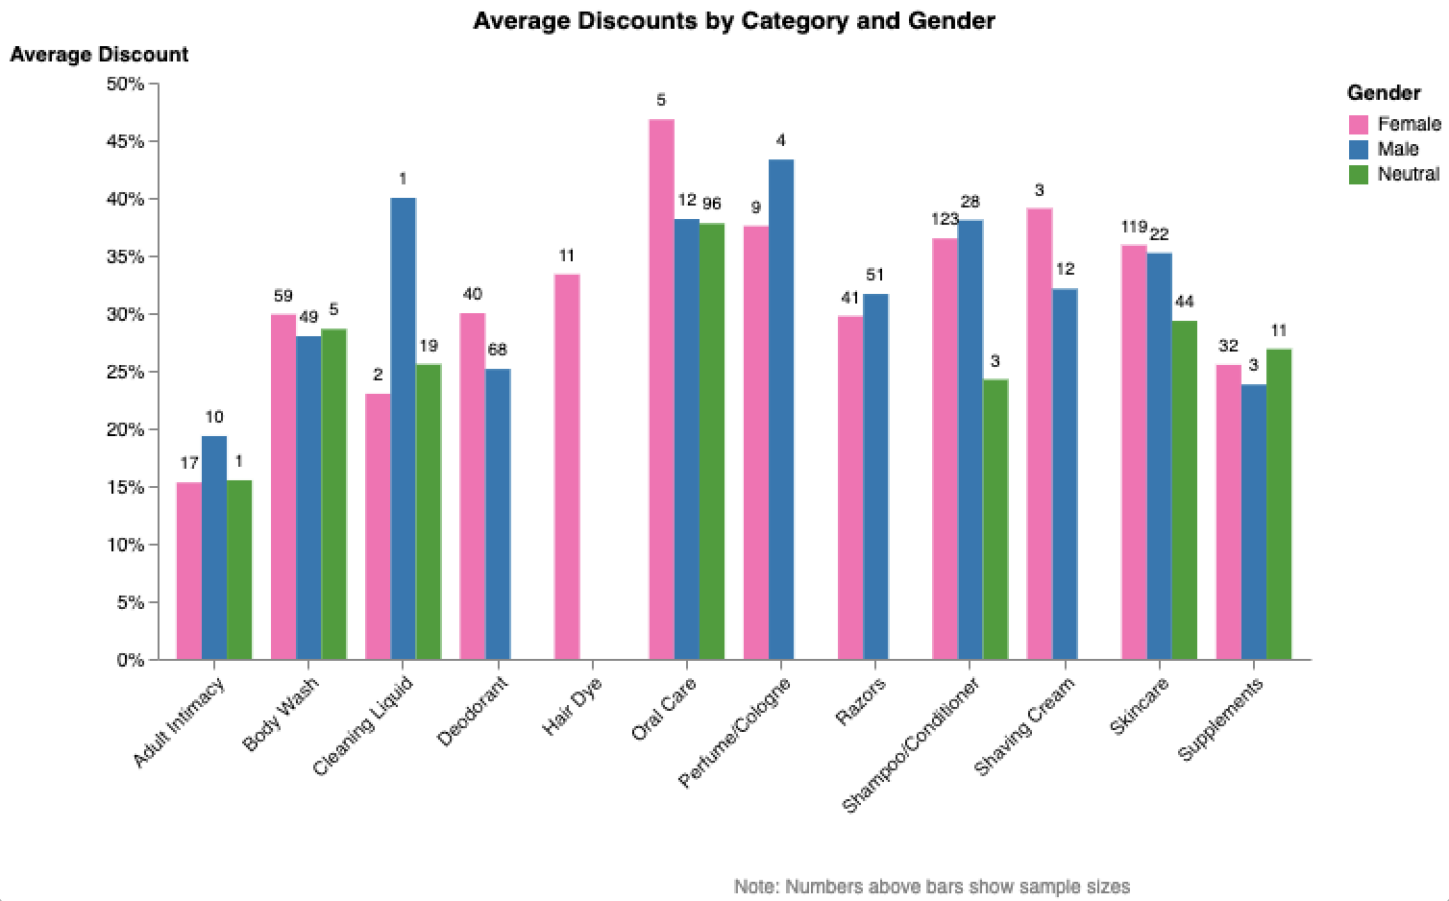
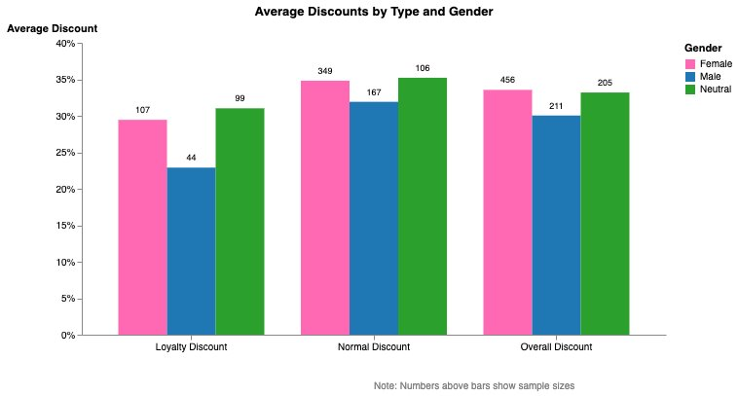
Price analysis
​
Discount differences
Women may receive greater average loyalty discounts
No significant difference between the size in discounts in male and female product overall
Results by category are inconclusive
Figure 7: Discount by type and gender
Figure 6: Discounts by category and gender
9

Slide 10
Is there a pink tax?
Our conclusions
Concur with past literature (Mosharys, et. al., 2023; Gonzalez, et. al., 2021), we find some evidence of an overall "pink gap”
The "pink gap" varies by product category
Indicate the larger gap between gendered and ungendered products.
While suggestive limitations prevent definitive answer
10

Slide 11
Limitations
Data
Data is only for January
Low power: sample size is too small
Missing image data weakened the image-based classifier
Methodological
Gendered products may be different in quality
Training labels were hand-coded, introducing subjectivity
Stacked model adds another layer of complexity
Potential issues with scaling up, e.g. hand cleaning prices, keywords
Extension of the research
Identify most common manufactures and include in the analysis
Add time-fixed effects in the future – sample only available for January
11

Slide 12
Appendix
12

Slide 13
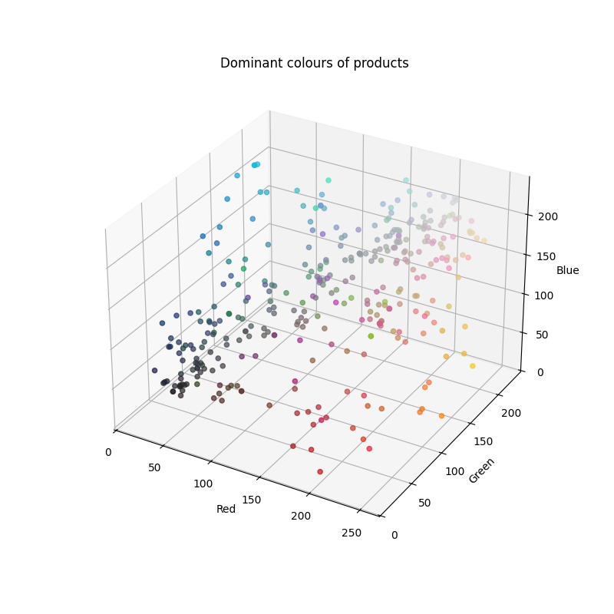
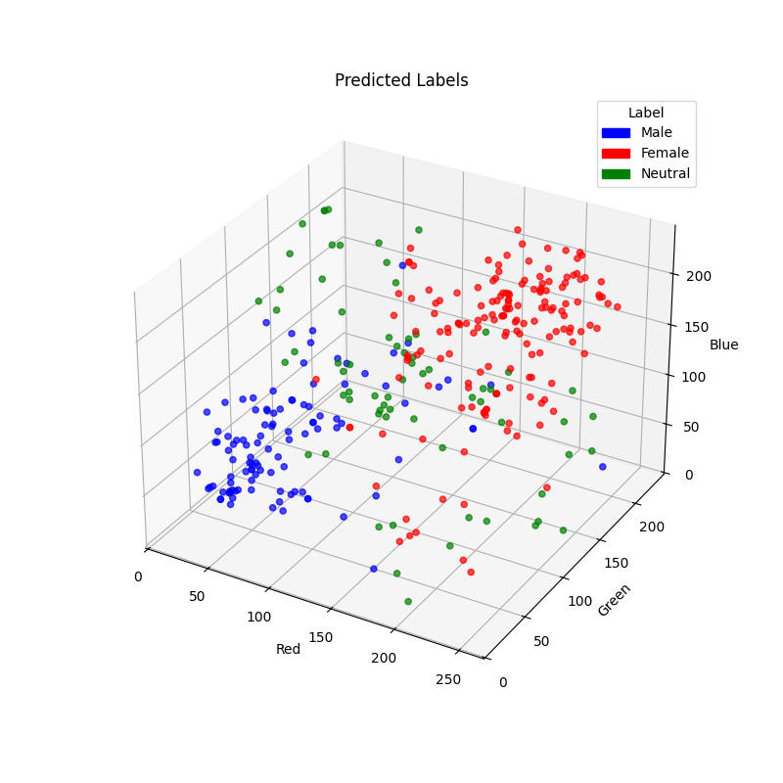
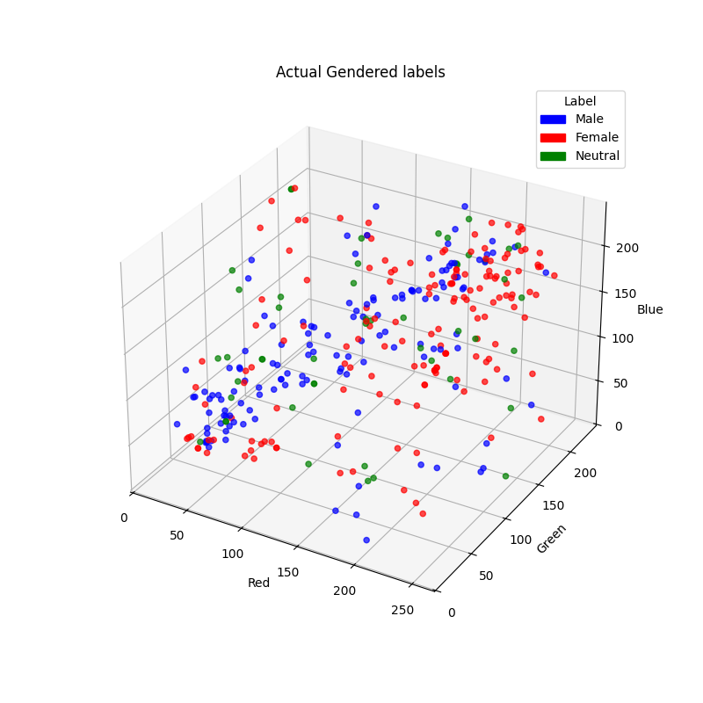
Gender classifier – Image processing
From each downloaded image, we get the dominant color.
Decomposed it in R, G and B values.
We assigned labels in a share of the data and then split into training and test data.
We fitted a logistic model and assigned female and male labels only when predicted probabilities were higher than 0.5.
Key insight: Male products tend to be darker and female products lighter and pinker.
However, low overall accuracy. Possible reasons:
Some colours may fit products targeted to both genders (e.g., light blue, red, gray, etc).
Colours' proximity to each other may not reflect the complexity of human perception about genders.
Figure 8: Dominant colours of products
Figure 9: Gender class prediction
Figure 10: Actual gender labels
13
Notes:
Image processing model:
We downloaded the images with the available URLs. We lost some observations on which URL was no longer available.
Using Kmeans, we identified the dominant color of each product. Number of clusters (K)=3.
We decomposed the dominant color in R, G and B values.
We merged that data with hand labelled data. We split this into training and test data (test = 30% of sample).
We fitted a Logistic regression to predict the label (female, male or neutral).
We assigned female or male labels only to predicted probabilities with a predicted probability higher than >0.5. Default is neutral. If female and male pred. probabilities were higher than 0.5, then the highest was assigned.
Accuracy score: 0.55
The model is not as accurate as the first two models. This is because some gendered targeted products for men and women have similar colours. Although there are some tendencies (male=darker colours, female=lighter/pink colours (see figure 2).
QUESTIONS:
Why is our model doing so poorly?
Some colours may fit products targeted to both genders (e.g., light blue, red, gray, etc).
Colours' proximity to each other may not reflect the complexity of human perception about genders.
How would you improve the model in the future?
We tried fitting the logit controlling by products' category. However, this improve accuracy.
We could try:
Fitting the model in a specific subsample. I.e. Shampoos/Conditioner or deodorants may be more "coloured".
Running the model could improve accuracy.

Slide 14
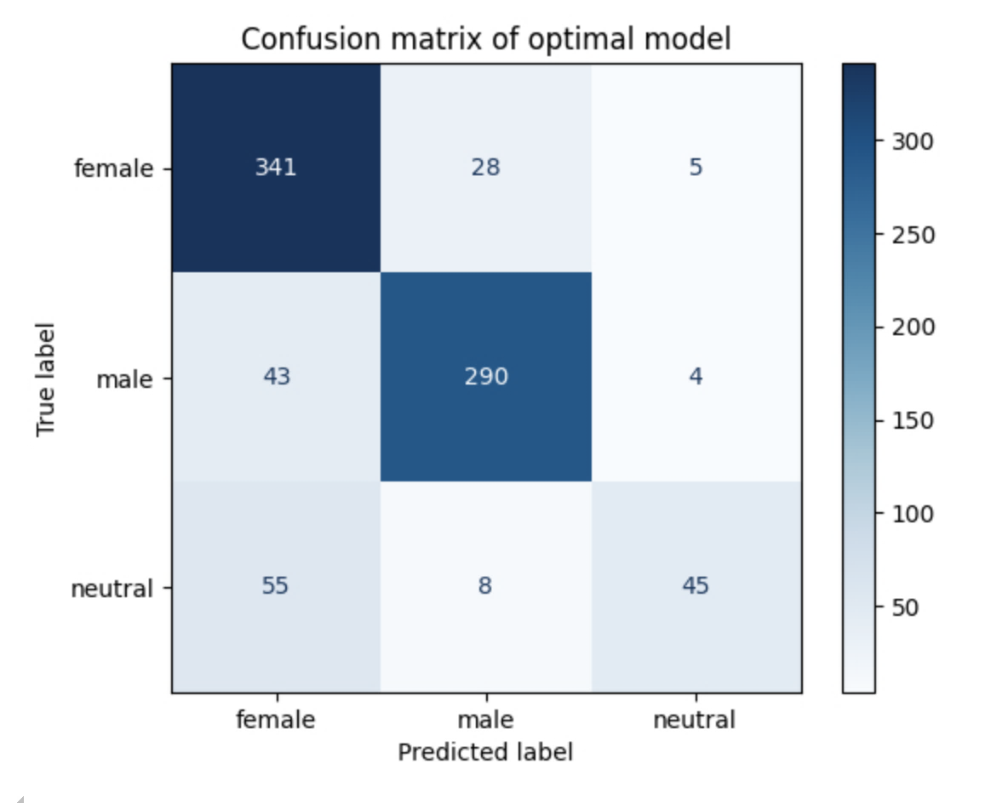
Gender classifier – Bag of words
Motivation behind this model:
language is a medium that strongly conveys gender messaging
Optimal parameters:
penalty: [l1, l2, elasticnet]
tfidf_min_df: 0.01,
tfidf__max_df: 0.8
Attempted random forest but over-fitting problems and long training time
Training Accuracy: 0.8920
Testing Accuracy: 0.8254
Figure 11: Confusion matrix, optimal bag of words
14

Slide 15
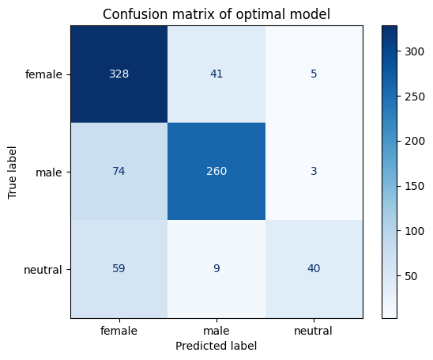
Gender classifier – Word embeddings
Motivation behind this model: encoders might capture gender biased associations between word meaning
Sentence transformer "all-MiniLM-L6-v2" that produces high-quality dense vector-embeddings from input (processed text data)
Other transformers (all-mpnet-base-v2) brought minimal improvements while substantially increasing encoding time
Struggled to differentiate between female and neutral
Training Accuracy: 0.81
Testing Accuracy: 0.77
Figure 12: Confusion matrix, text embedding model
15

Slide 16
Gender classifier – stacked model
Best balanced performing model across all three categories
Particularly strong at identifying female-targeted products with recall at 90%
Training Accuracy: 0.90
Testing Accuracy: 0.83
Figure 13: Confusion matrix, stacked model
16

Slide 17
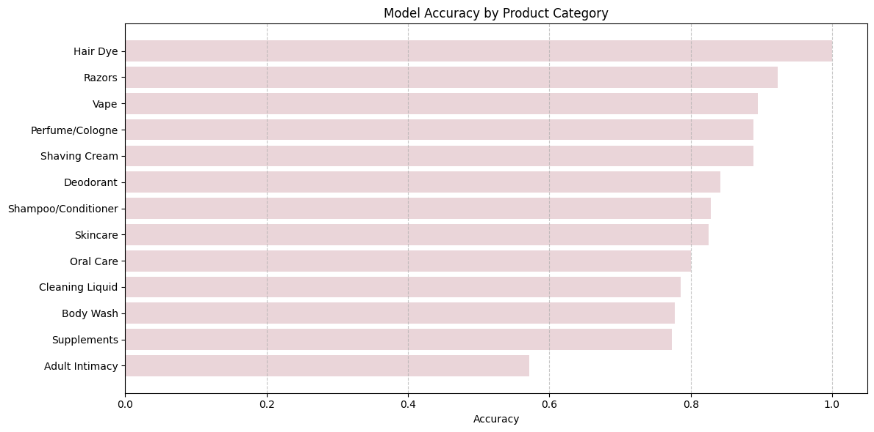
Performance across product categories
Model performs significantly better for categories with female gendered products and worse for neutral categories
Our stacked model's accuracy is closely linked with class balance. Hair Dye is entirely female, while razors are more targeted towards men, and vape are considered neutral products.
Figure 14: Stacked Model accuracy according to category
17

Slide 18
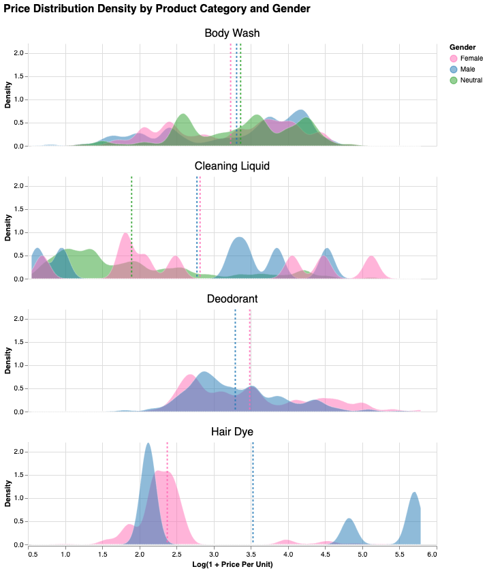
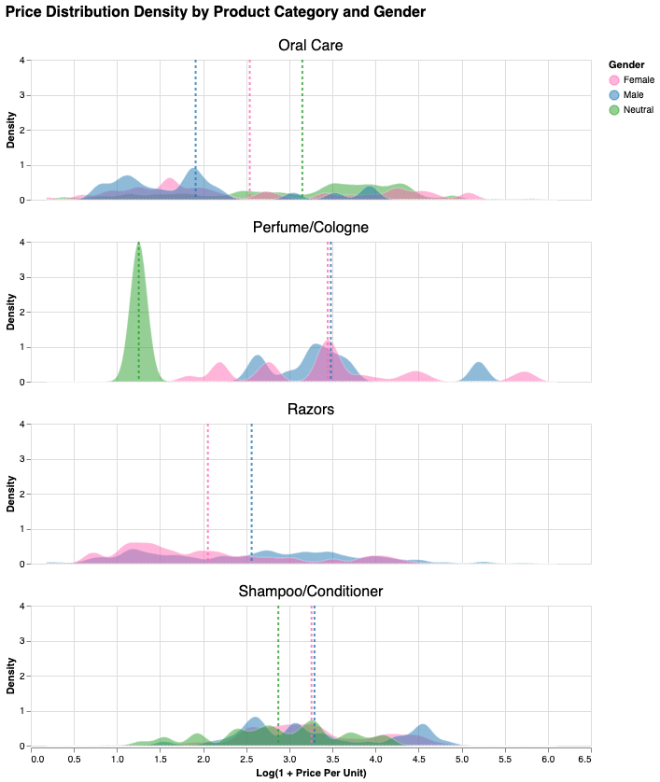
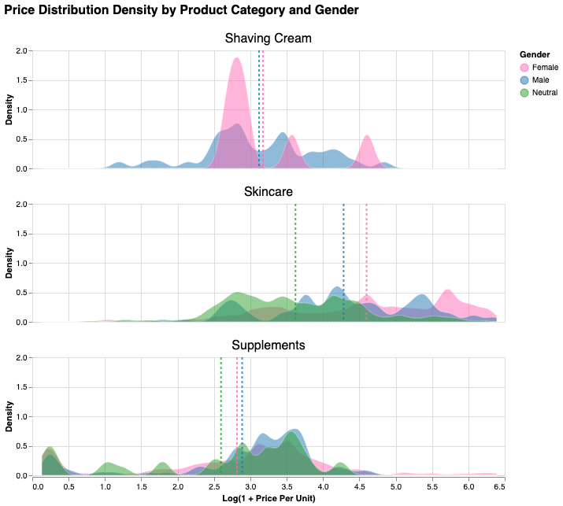
Distributions by category
18

Slide 19
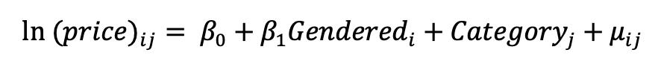
Model Specifications
Specification 1:
Specification 2:
Specification 3:
19

Slide 20
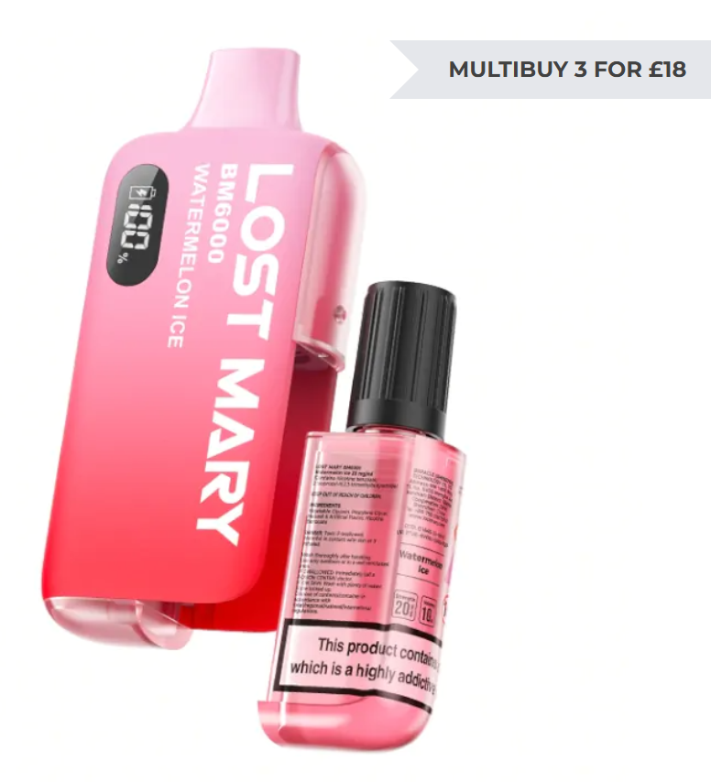
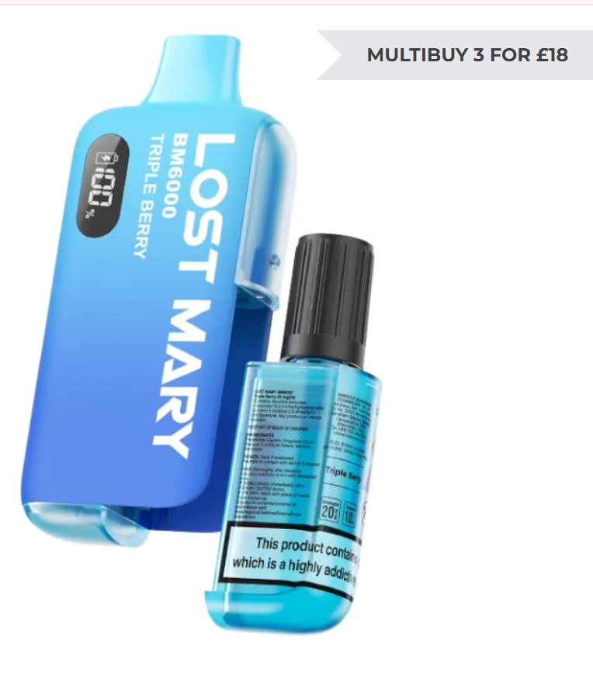
Miscellaneous
Categories keywords:
"Perfume/Cologne": {"perfume", "cologne", "eau de toilette", "eau de parfum", "parfum", "aftershave", "body mist"}
Explicit label keywords:
female_keywords = {"women", "female", "girl", "ladies", "her", "feminine", "lady", "woman", "girls", "makeup", "make up", "nailpolish", "nail polish", "pregnant", "menopause", "conception", "pregnancy", "for her", "hers"}
During our analysis some products had to be manually handled,
e.g. Razors - brand of scooters
Some categories might appear to be gendered but are not.
For example, vapes, although are vividly coloured, are not gendered but tend to be coloured according to flavour
Figure 15: Vapes are coloured according to flavour
20

Slide 21
References
Economics Observatory. (2025). Web scraped Price Data. https://dspp-pp422-mini-capstone-materials.pages.dev/
Gonzalez Guittar, S., Grauerholz, L., Kidder, E. N., Daye, S. D. and McLaughlin, M. (2021). 'Beyond the Pink Tax: Gender-Based Pricing and Differentiation of Personal Care Products', Gender Issues, 38(3), pp. 281-302. Available at: https://link.springer.com/article/10.1007/s12147-021-09280-9 [Accessed 3 Feb. 2025].
Moshary, S., Tuchman, A., and Vajravelu, N. (2023) Gender-Based Pricing in Consumer Packaged Goods: A Pink Tax?. Marketing Science 0(0).
https://doi.org/10.1287/mksc.2023.1452
21

